Slide 1

CYBERSENTINAL - AI - Powered Phishing and Fraud Detection System
TEAM MEMBERS :
Vaishnavi Dasari – vd73531n@pace.edu
Snehitha Bodiga – sb65320n@pace.edu
Shoib Khan Patan – sp05764n@pace.edu
Abisainath Arepalli– aa98295n@pace.edu
Aasritha Bhimisetty – ab74717n@pace.edu
Neelkamal Rana – nr37172n@pace.edu
Dhanush Kolapalli – dk25992n@pace.edu

Slide 2
Project description
Project Name: | CyberSentinel
Team: | Tech Titans
Project Description: | CyberSentinel is an AI-powered cybersecurity platform that helps individuals and businesses detect phishing emails, fraudulent transactions, and scam websites using AI-driven risk analysis.
For | businesses and individuals
Who | need to protect their sensitive data from cyber threats
The | CyberSentinel platform
Is a | real-time fraud detection and prevention system
That | scans emails, transactions, and web links using machine learning and AI to identify phishing and fraud attempts
Unlike | traditional security filters and manual verification
Our application | provides real-time AI-driven alerts and a proactive security layer to prevent cyber fraud before it happens

Slide 3
Benefit outcomes
Reduced financial loss due to fraud and phishing.
Real-time alerts and proactive security measures.
Enhanced protection for businesses and individuals against cyber threats.
AI-driven accuracy improves over time with machine learning.

Slide 4
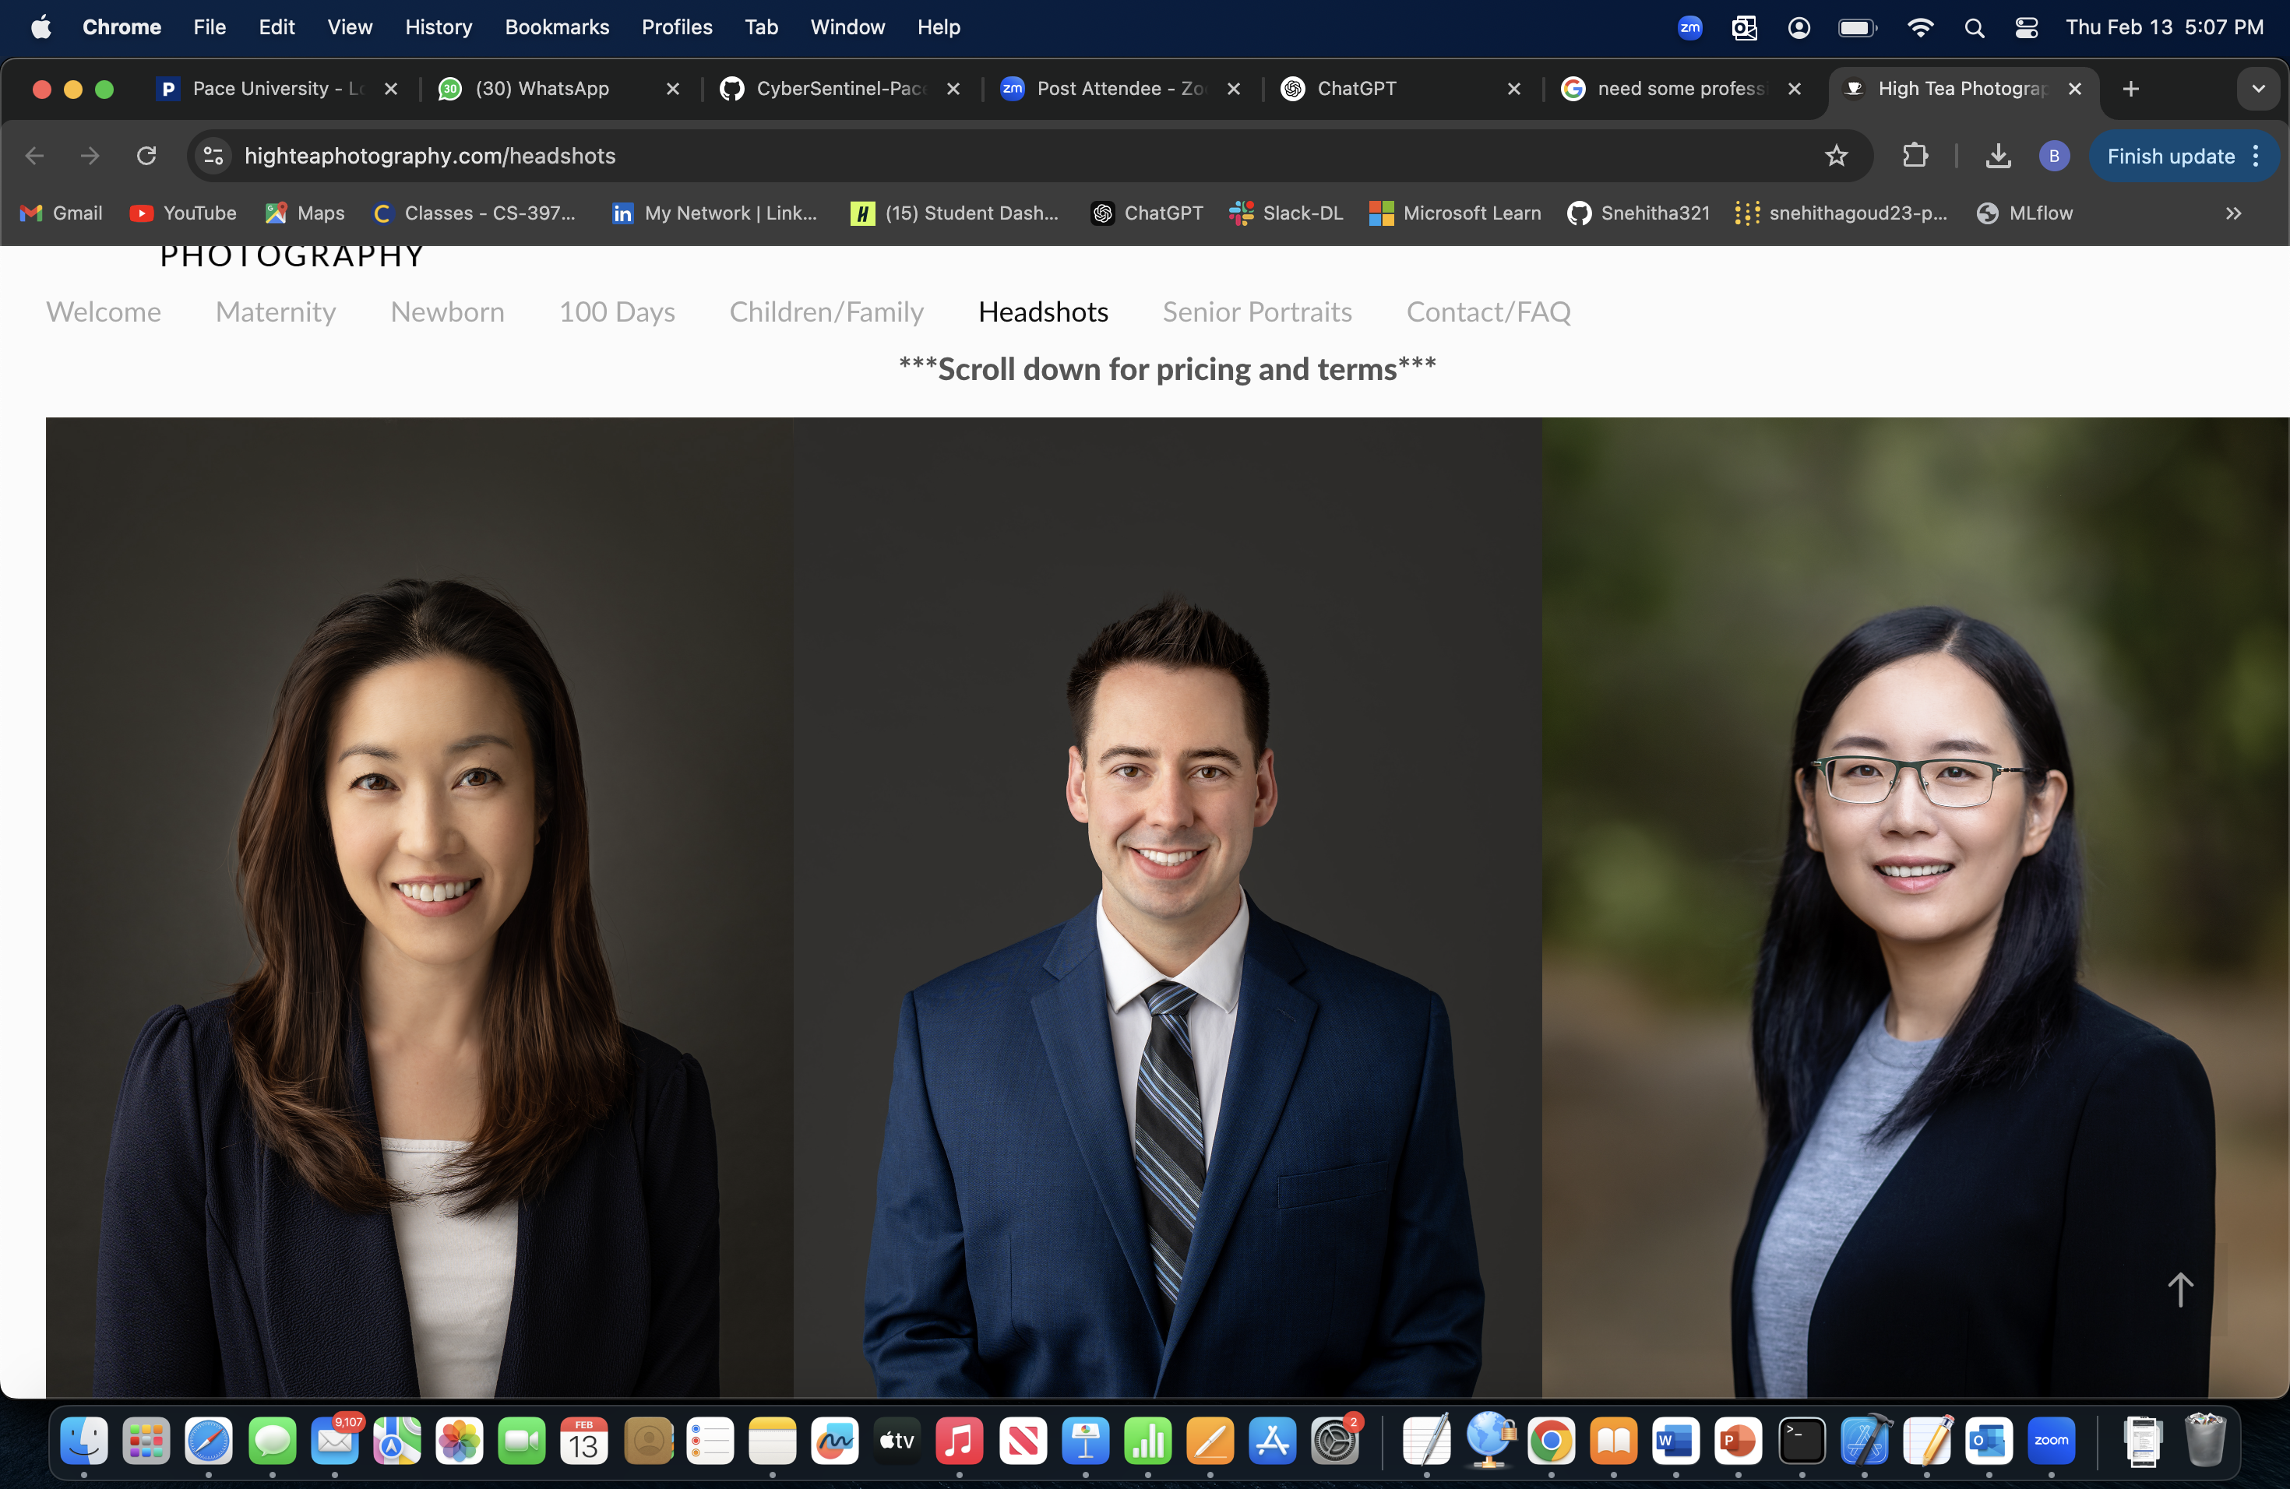
Persona
Alex works at a mid-sized tech company and is well-versed in various technologies. Spends considerable time online, both professionally and personally. Aware of cybersecurity threats but seeks advanced tools to enhance personal security.
Goals:
Protect personal and professional data from phishing and other cyber threats.
Stay informed about the latest cybersecurity practices.
Utilize AI-driven solutions for proactive threat detection.
Challenges:
Balancing convenience with robust security measures.
Identifying trustworthy cybersecurity tools amidst numerous options.
Name: Alex Johnson
Age: 32
Occupation: Software Developer

Slide 5
Persona
Manages a team remotely for a marketing firm. Juggles professional responsibilities with parenting two teenagers. Uses multiple devices for work and personal tasks.
Goals:
- Ensure the security of sensitive work-related information.
- Protect family members, especially children, from online threats.
- Maintain a secure digital environment across all devices.
Challenges:
- Limited time to manage and monitor cybersecurity measures.
- Keeping up with evolving cyber threats and ensuring family compliance with best practices.
Name: Maria Thompson
Age: 40
Occupation: Project Manager

Slide 6
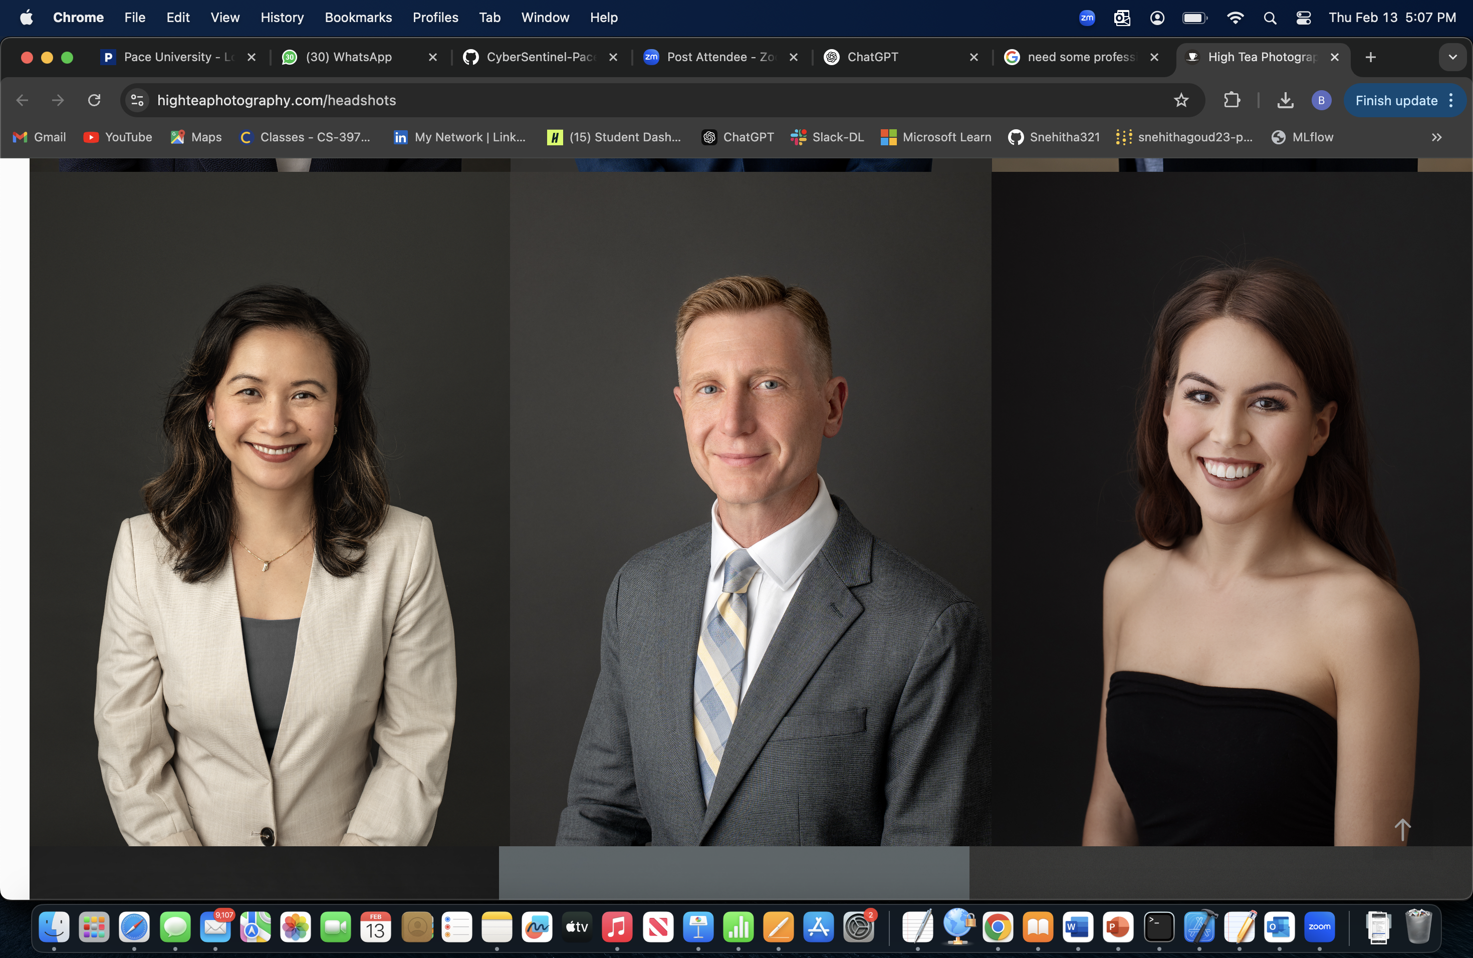
persona
Runs an online storefront in addition to the physical store. Handles customer data, including payment information. Has basic knowledge of cybersecurity but lacks specialized expertise.
Goals:
- Protect customer data to maintain trust and comply with regulations.
- Prevent financial losses due to cyber attacks.
- Implement cost-effective security solutions without extensive technical knowledge.
Challenges:
- Limited budget for cybersecurity investments.
- Difficulty in assessing which security measures are necessary and effective.
Name: David Kim
Age: 45
Occupation: Owner of a local retail store

Slide 7

Overview
CyberSentinel is a cybersecurity platform designed to detect:
Phishing emails
Fraudulent transactions
Scam websites
Uses AI-driven risk analysis for real-time detection.
Protects individuals and businesses from cyber threats.

Slide 8
Problem Statement
Phishing & Fraud are Growing Threats:
Email scams steal personal & financial data.
Fake websites deceive users into entering sensitive information.
Fraudulent transactions cause financial losses.
Existing Security Measures are Limited:
Traditional filters fail against sophisticated attacks.
Need for AI-powered real-time detection.

Slide 9
How CYBERSENTINAL WORKS?
AI & Machine Learning: Detects phishing patterns in emails, transactions, and websites.
NLP for Email Analysis: Identifies suspicious language and phishing attempts.
Computer Vision: Detects fake websites and fraudulent UI elements.
Real-time Monitoring: Flags and prevents fraud attempts before they cause harm.

Slide 10
TECH STACK
Frontend: React.js (Web), React Native (Mobile)
Backend: Fast API (AI detection), Node.js (API management)
Database: DynamoDB (fraud data), MongoDB (user logs)
AI Model: NLP (email analysis), Image recognition (website fraud)
Cloud Services: AWS Lambda (real-time scanning), AWS S3 (logs)
Authentication: AWS Cognito/Firebase
Deployment: AWS Fargate, Kubernetes
Other Tools: OpenAI API (pattern detection), Selenium (scam site scraping)

Slide 11
KEY FEATURES
Phishing Email Detection:
Scans and flags suspicious emails in real time.
Fraudulent Transaction Monitoring:
Identifies abnormal transaction behavior.
Scam Website Detection:
Uses AI-based image and text analysis to flag fake sites.
Real-time Alerts: Notifies users of potential threats instantly.
Interactive Dashboard:
Provides security insights and threat analytics.

Slide 12
TEAM DIVISION
AI/ML Engineer: Builds phishing detection & fraud analysis models.
Frontend Developer (Web): Creates an interactive dashboard.
Frontend Developer (Mobile):
Develops mobile alerts & monitoring UI.
Backend Developer: Develops fraud detection APIs & AI integration.
Database Engineer: Manages scam/phishing detection logs.
DevOps Engineer: Deploys and secures microservices on AWS.
Cybersecurity Analyst:
Ensures security compliance & ethical hacking.

Slide 13
WORK FLOW EXAMPLE
User receives an email → Scanned by NLP phishing model.
User clicks on a link → Checked by image recognition & web scraping.
Transaction detected → Verified by fraud detection model.
Real-time alert → Sent to user dashboard & mobile app.

Slide 14
SECURITY COMPLIANCE
Encryption: Secure storage of flagged data.
User Privacy: No sensitive data stored permanently.
Regulatory Compliance: GDPR, SOC2, ISO 27001 standards.
Ethical Hacking: Regular penetration testing for security assurance.

Slide 15
FUTURE ENHANCEMENTS
AI-Powered Voice Scam Detection for phone calls.
Blockchain-based Fraud Prevention for transactions.
Deep Web Monitoring for new scam patterns.
Self-Learning AI Models for improving accuracy over time.

Slide 16

CONCLUSION
CyberSentinel provides real-time AI-driven fraud detection.
Enhances cybersecurity for individuals & businesses.
Future-ready architecture with advanced AI models.
Stronger defense against evolving phishing and fraud threats.

Slide 17

wIKI PAGE LINK
To see our progress visit the wiki page below:
https://github.com/htmw/2025S-Tech-Titans/wiki/CyberSentinel%E2%80%90Pace-University-Capstone-Project

Slide 18


